Slide 1
Promoting Coordination through Policy Regularization in Multi-Agent Deep Reinforcement Learning
Literature review

Slide 2
Contents
1
Motivation
2
Methodology
3
Empirical study

Slide 3

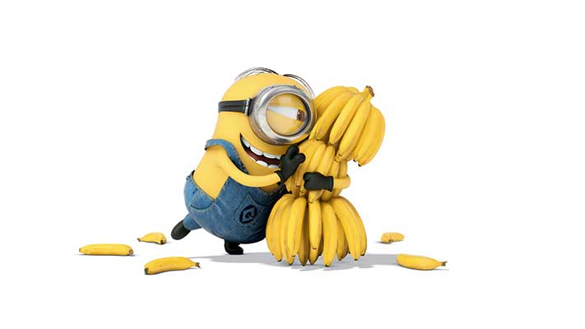
1 Motivation
Learn to get largest cumulative reward
Efficient agent-wise policy exploration is appealing to train independent agent
Agent

Slide 4
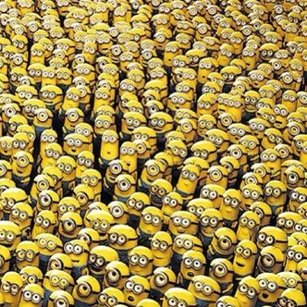
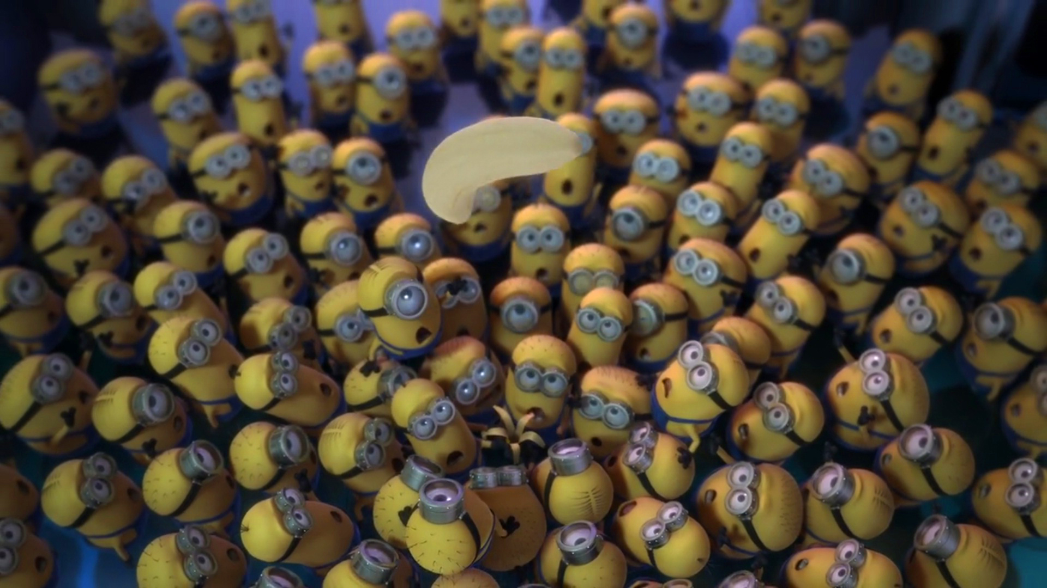
1 Motivation
Efficient agent-wise policy exploration is appealing to train independent agent
Agent
Explore successive collective policies is less tractable due to the large joint-action space
Agents

Slide 5
1 Motivation
Coordinating the agents’ policies can guide their exploration

Slide 6
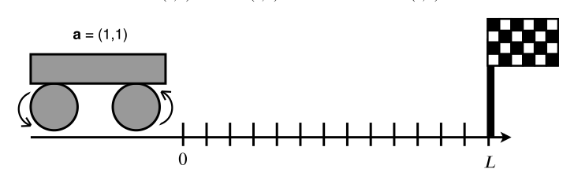
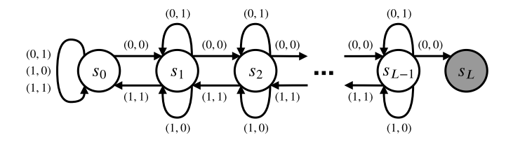
1 Motivation
Coordinating the agents’ policies can guide their exploration
Goal
a=0: move right
a=1: move left
Agent 1
Agent 2

Slide 7
1 Motivation
Coordinating the agents’ policies can guide their exploration
Goal
a=0: move right
a=1: move left
Agent 1
Agent 2
For transition to a different state both agents need to perform the same action at the same time

Slide 8
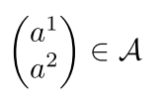
1 Motivation
Coordinating the agents’ policies can guide their exploration
Goal
a=0: move right
a=1: move left
Agent 1
Agent 2
joint action space

Slide 9
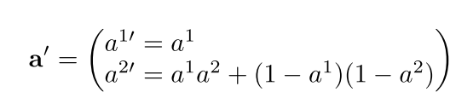
1 Motivation
Coordinating the agents’ policies can guide their exploration
Goal
a=0: move right
a=1: move left
Agent 1
Agent 2
Impose joint action structure
joint action space
Mapped joint action space

Slide 10
1 Motivation
Coordinating the agents’ policies can guide their exploration
Goal
a=0: move right
a=1: move left
Agent 1
Agent 2
Agent 2’s action is conditioned on Agent 1
Impose joint action structure
joint action space
Mapped joint action space

Slide 11
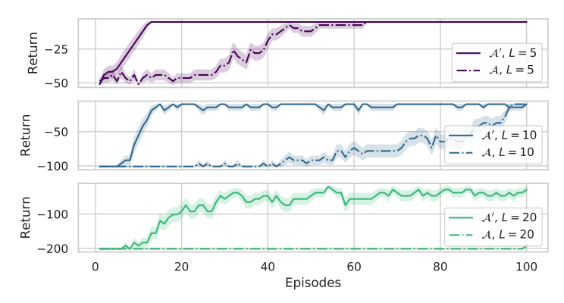
1 Motivation
Coordinating the agents’ policies can guide their exploration
Learning is much more efficient on the task with a constraint enforcing coordination.

Slide 12
1 Motivation
How
Coordinating the agents’ policies can guide their exploration

Slide 13
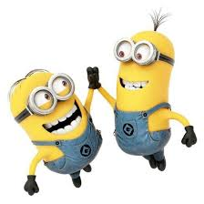
1 Motivation
How
Coordinating the agents’ policies can guide their exploration
Agents predict (know) their teammate’s policies
Team regularization (TeamReg)

Slide 14
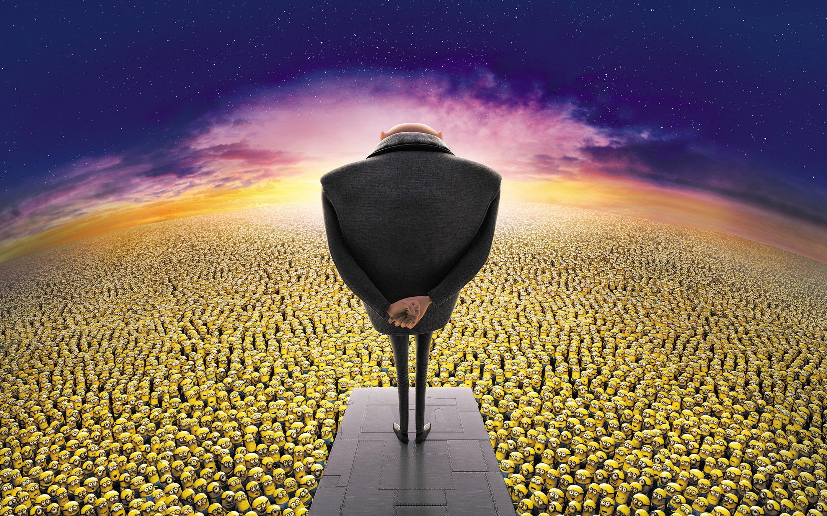
1 Motivation
How
Coordinating the agents’ policies can guide their exploration
Agents predict (know) their teammate’s policies
A center(coach) modulates agent’ policies
Team regularization (TeamReg)
Coach regularization (CoachReg)

Slide 15
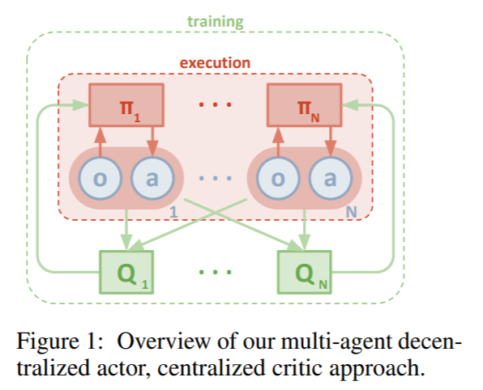
2 Methodology
Team regularization
1) Train a centralized critics to approximate the value function of the aggregated observations-actions pairs.
2) Train actors restricted to the observation of a single agent.
---------------------MADDPG
Source: https://arxiv.org/pdf/1706.02275.pdf

Slide 16
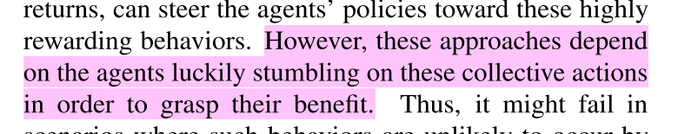
2 Methodology
Team regularization
1) Train a centralized critics to approximate the value function of the aggregated observations-actions pairs.
2) Train actors restricted to the observation of a single agent.
---------------------MADDPG
Source: https://arxiv.org/pdf/1706.02275.pdf

Slide 17
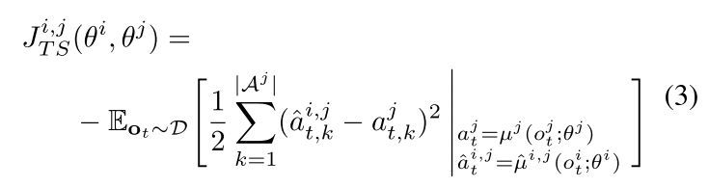
2 Methodology
Team regularization
Promote agents’ predictability
Teammate’s actual action
Train agent to better estimate his teammate’s policy
(similar to MADDPG)
Teammate’s actual action approximator

Slide 18
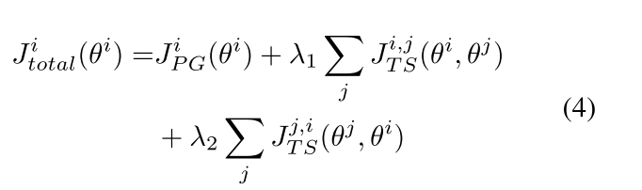
2 Methodology
Team regularization
Promote agents’ predictability
Teammate’s actual action
Train agent to better estimate his teammate’s policy
(similar to MADDPG)
Teammate’s actual action approximator
A agent not only can estimate teammates’ polices well, but also be estimated by teammate well.

Slide 19
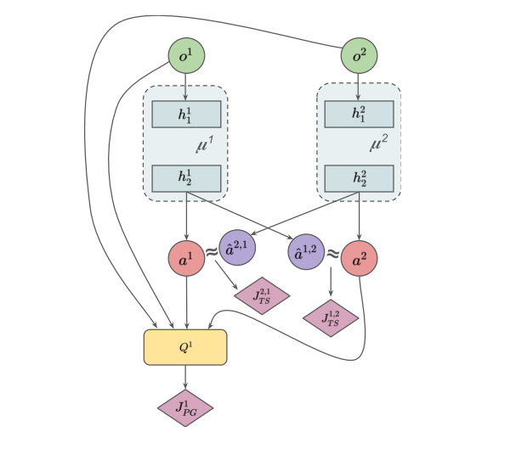
2 Methodology
Team regularization
Policy loss to train the actor

Slide 20
2 Methodology
Team regularization
Policy loss to train the actor
Approximated long-term reward

Slide 21
2 Methodology
Team regularization
Policy loss to train the actor
Promote agents’ predictability

Slide 22
2 Methodology
Team regularization
Policy loss to train the actor
Each agent’s policy is equipped with additional heads that are trained to predict other agents’ actions.
But it seems that the local observation makes no sense.
Promote agents’ predictability

Slide 23
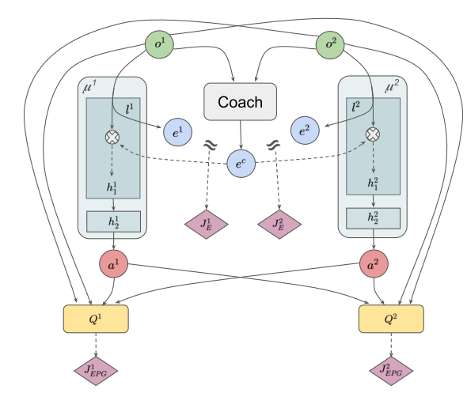
2 Methodology
Coach regularization

Slide 24
2 Methodology
Coach regularization
A coach who can observe global information teach each agent how to perform for a better coordination by output a global policy mask,

Slide 25
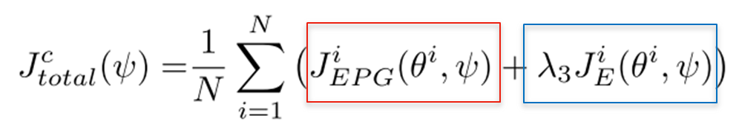
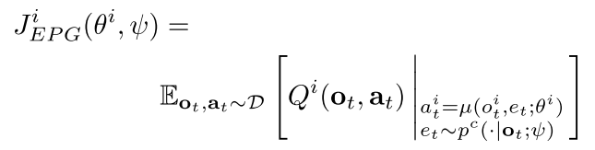
2 Methodology
Coach regularization
Train the coach to:
yield high returns when used by the agents
be predictable by the agents

Slide 26
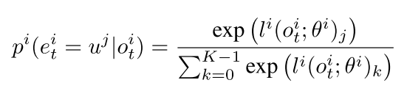
2 Methodology
Coach regularization
Each actor should learn a policy mask acting in the hidden layer of actor neural network.
Hidden neuron

Slide 27
2 Methodology
Coach regularization
Each actor should learn a policy mask acting in the hidden layer of actor neural network.
Sub-policy k=1
mask
Hidden neuron

Slide 28
2 Methodology
Coach regularization
Each actor should learn a policy mask acting in the hidden layer of actor neural network.
Sub-policy k=2
mask
Hidden neuron

Slide 29
2 Methodology
Coach regularization
Each actor should learn a policy mask acting in the hidden layer of actor neural network.
Sub-policy k=3
mask
Hidden neuron

Slide 30
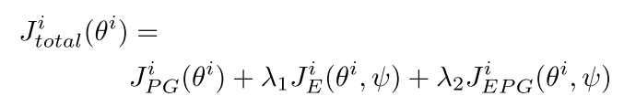
2 Methodology
Coach regularization
Each actor should learn a policy mask acting in the hidden layer of actor neural network.

Slide 31
2 Methodology
Coach regularization
Each actor should learn a policy mask acting in the hidden layer of actor neural network.
Policy loss based on agent’s own policy mask

Slide 32
2 Methodology
Coach regularization
Each actor should learn a policy mask acting in the hidden layer of actor neural network.
Policy loss based on agent’s own policy mask
Evaluate distance between self-mask and coach mask

Slide 33
2 Methodology
Coach regularization
Each actor should learn a policy mask acting in the hidden layer of actor neural network.
Policy loss based on agent’s own policy mask
Evaluate distance between self-mask and coach mask
Policy loss based on coach policy mask

Slide 34
2 Methodology
Team regularization
VS
Coach regularization
Promote agent predictability (Encourage agent to predict others policies and itself to be easier to be predicted).
Manipulate the hidden layer of actor (Stable ?)

Slide 35
2 Methodology
Team regularization
VS
Coach regularization
Local information is used to promote coordination during train or execution.
Global information is used to train coordination (synchronicity) and local information is used during execution.

Slide 36
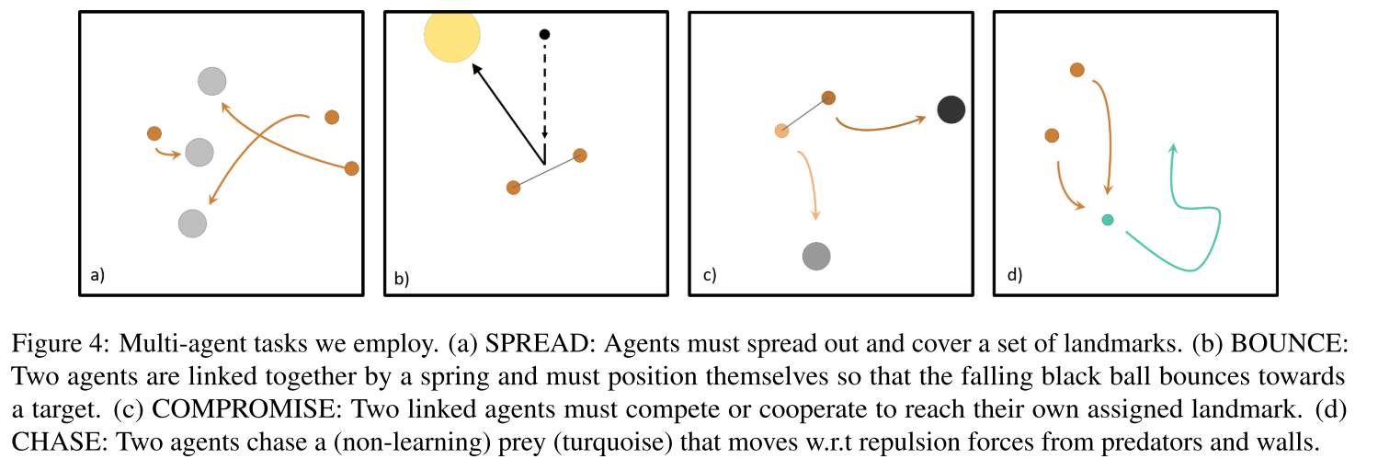
3 Experiments
DDPG
MADDPG
MADDPG + sharing: shares the policy and value-function models across agents.
MADDPG + agent modelling : : similar to TeamReg but not encourage agent predictability.
MADDPG + policy mask: similar to CoachReg but not encourage synchronicity.
MADDPG + TeamReg
MADDPG + CoachReg
Baselines
Environment

Slide 37
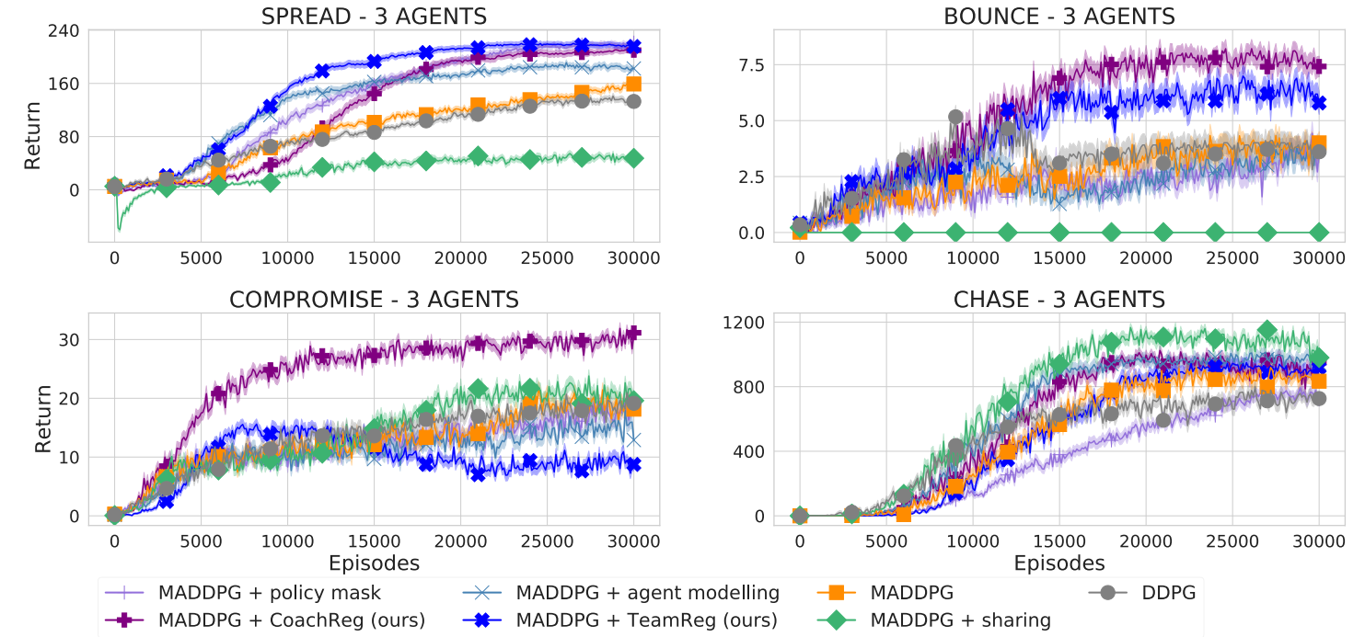
3 Experiments
Overall performance

Slide 38
3 Experiments
Explore MADDPG + TeamReg
Using a predictability-based team-regularization in a competitive task can be harmful.

Slide 39
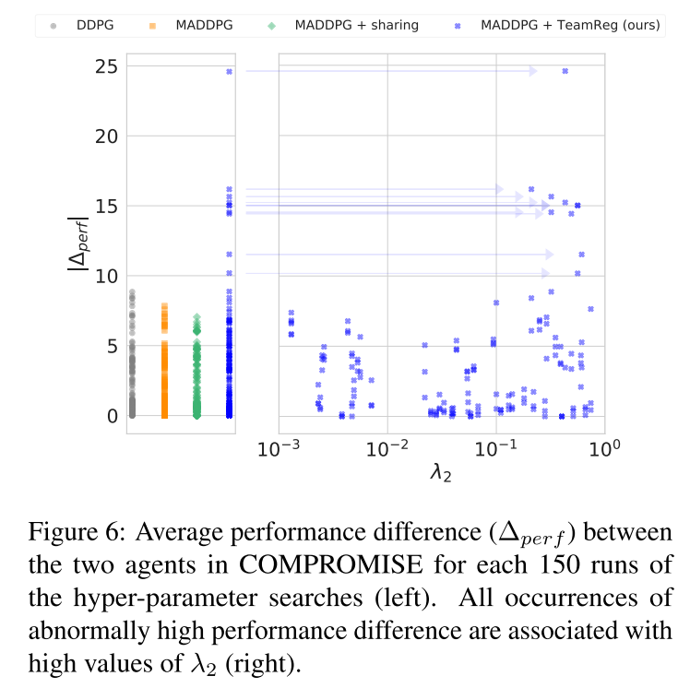
3 Experiments
Explore MADDPG + TeamReg
High performance different between agents with MADDPG+TeamReg in competitive task
Using a predictability-based team-regularization in a competitive task can be harmful.

Slide 40
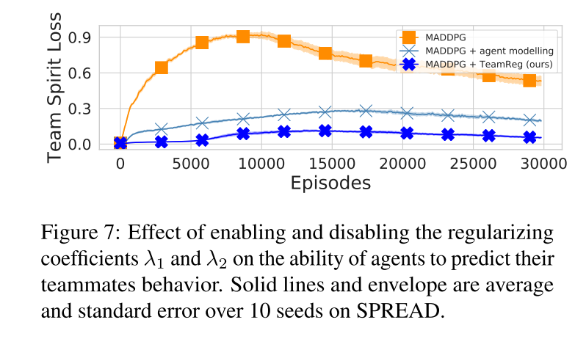
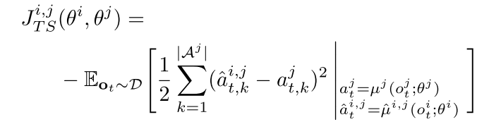
3 Experiments
Explore MADDPG + TeamReg
Validate the function of teamReg in predicting teammates behavior

Slide 41
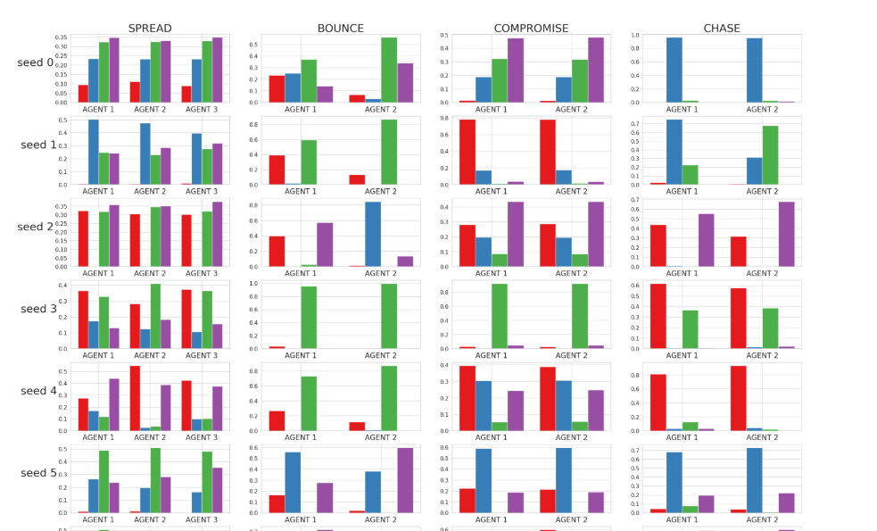
3 Experiments
Explore MADDPG + CoachReg
Sub-policy distribution
Agents tend to switch sub-policy (i.e., use different mask in hidden layer)

Slide 42
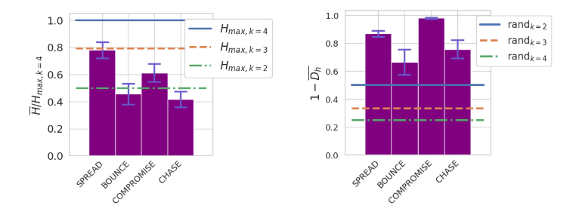
3 Experiments
Explore MADDPG + CoachReg
Mask distribution entropy compared to that of Categorical Uniform Distribution
In SPREAD, entropy of mask distribution is closed to Categorical Uniform Distribution of size 3
Agents tend to switch sub-policy (i.e., use different mask in hidden layer)

Slide 43
3 Experiments
Explore MADDPG + CoachReg
Hamming proximity between the agents’ mask sequences
Agents tend to select the same mask for synchronicity.

Slide 44
Thank you !

Slide 45
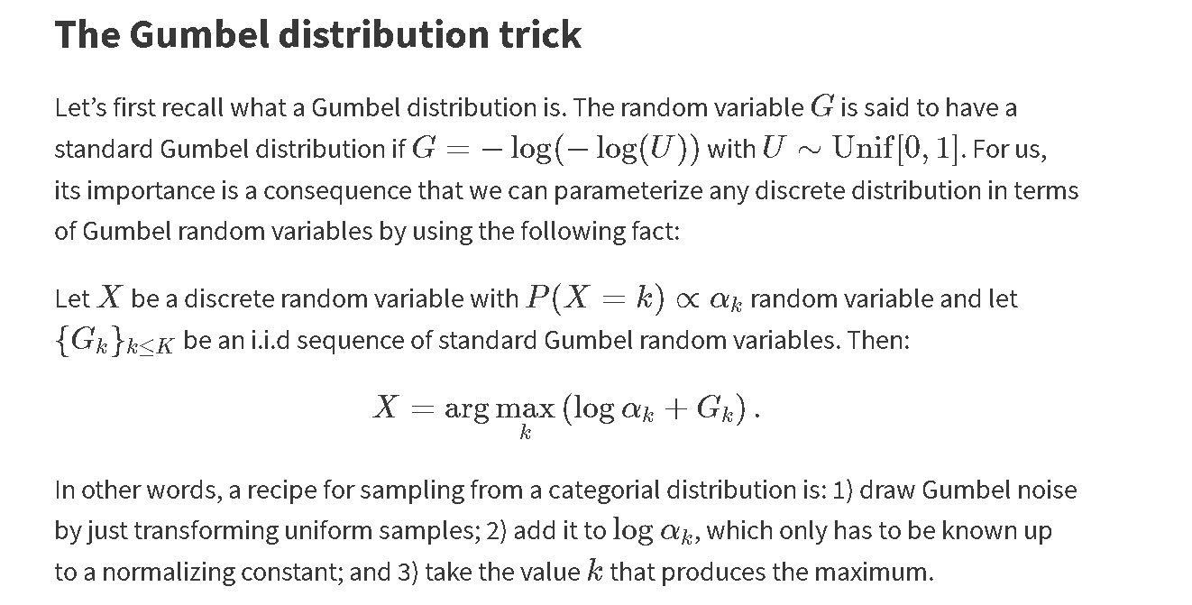
Gumbel-softmax trick
Notes:
http://users.umiacs.umd.edu/~jbg/teaching/CMSC_726/18d.pdf

